Slide 1
Designing a Digital Twin-Enabled Requirement Verification Workflow within an MBSE Framework
Omar Zeki, Farid Sahebsara, Mohammadreza Torkjazi, Michael R. Hieb, Ali K. Raz, and Louis (Bill) Berklich*
C5I Center, Systems Engineering and Operations Research Department,
George Mason University, Fairfax, VA
*US Army Ground Vehicle System Center
Warren, MI, USA
DISTRIBUTION STATEMENT A.
Approved for public release; distribution is unlimited. OPSEC #10918
Notes:
Good afternoon, and thank you for joining me today. My name is Omar Zeki. I am a graduate research assistant in the Systems Engineering and Operations Research Department at George Mason University.
The paper is "Designing a Digital Twin-Enabled Requirement Verification Workflow within an MBSE Framework." This work was conducted at the George Mason C5I Center with my co-authors: Dr. Farid Sahebsara, Dr. Mohammadreza Torkjazi, Dr. Michael Hieb, and Dr. Ali Raz, and Bill Berklich at the U.S. Army Ground Vehicle Systems Center.
I will cover the motivation, background on digital twins and MBSE, the gap between them, the workflow we developed, and our conclusions.

Slide 2
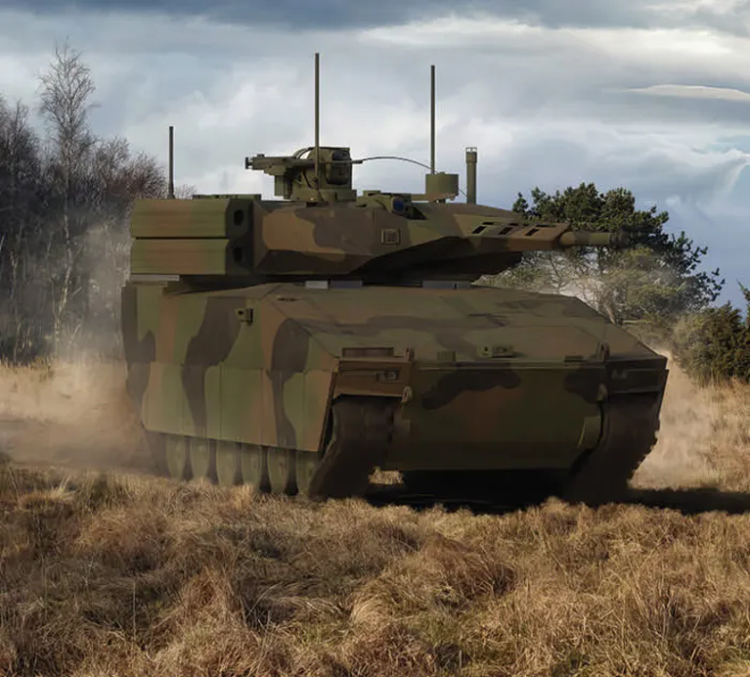
Motivation: Acquisition of Autonomous Ground Vehicle
Acquisition decisions rest on evidence that the system satisfies its requirements. For autonomous ground vehicles, that evidence comes from physical prototypes and field experimentation, limiting how early, how often, and how affordably a design can be evaluated.
Three challenges:
Costly physical testing: building and breaking prototypes is slow, expensive, and risky
Disconnected tools: design models, simulations, and real-world data live in separate silos
Lost traceability: requirements get disconnected from test results over the vehicle lifecycle
What if we could verify virtually first, before building physical prototypes?
2
Notes:
Acquisition decisions rest on evidence that the system satisfies its requirements. For autonomous ground vehicles that evidence comes from physical prototypes and field testing, which limits how early and how affordably a design can be evaluated. Three challenges follow.
[Click 1] The first is the cost of physical testing. Building and testing prototypes is slow, expensive, and in some cases introduces safety risk.
[Click 2 ] The second is tool fragmentation. Design models, simulation environments, and field data sit in separate tools owned by separate teams.
[Click 3 ] The third is loss of traceability. Requirements are written early and results arrive much later, so the link between them degrades.
[Click 4 ] That leads to the question this work addresses: can verification be performed virtually, and traceably, before physical prototypes are committed.

Slide 3
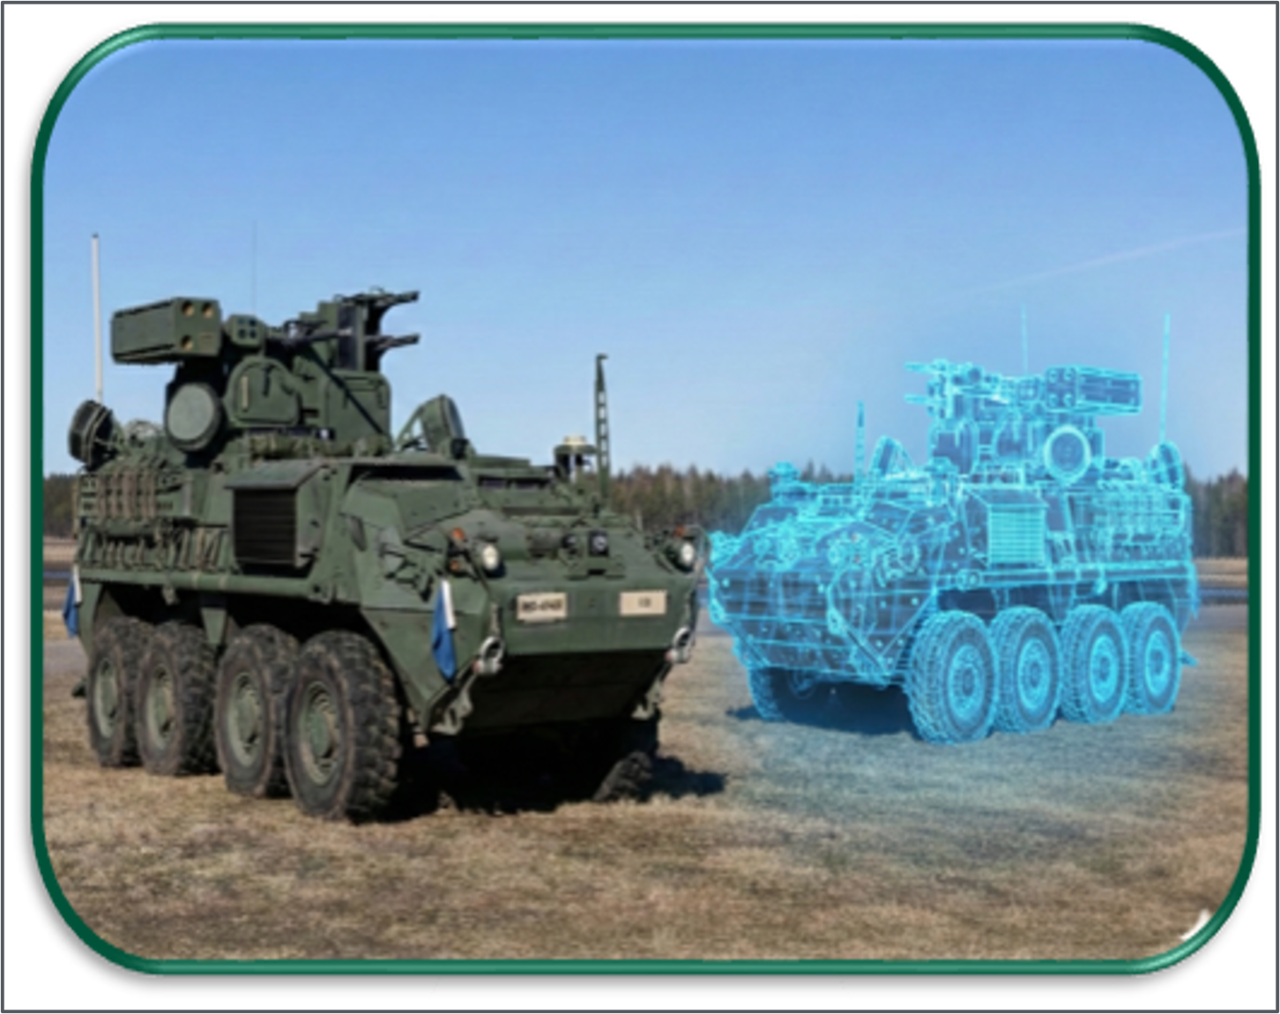
Background: Digital Twins
A Digital Twin is a computerized representation (integrated set of models) that serves as the real-time digital counterpart of a physical object or process
[DoD Instruction 5000.97]
A Digital Twin can:
Mirror the structure and behavior of the physical system
Update in real time as the real system changes
Predict problems before they happen in the field
Communicate both ways: virtual informs physical, and physical feeds back to virtual
But a Digital Twin on its own isn't enough. It needs a structured engineering process to govern it.
Source: National Academies of Sciences, 2024
3
Notes:
The first element of the approach is the digital twin.
Department of Defense Instruction 5000.97 defines a digital twin as an integrated set of models serving as the real-time digital counterpart of a physical object or process. That real-time relationship is what separates it from a conventional simulation.
[Clicks 1 through 4 ] A digital twin mirrors the structure and behavior of the physical system. It updates as that system changes. It supports predicting problems before they occur in the field. And it communicates in both directions.
[Click 5 ] A digital twin alone is not sufficient. It provides fidelity, not a governing process. Without one, it is a high-cost simulation with no formal link to the requirements it is meant to verify.

Slide 4
Model Based Systems Engineering
MBSE replaces disconnected documents and siloed tools with a single, shared digital model that acts as the single source of truth. Multiple engineering disciplines works from the same baseline.
Requirements
Capture and trace system needs
Shared System
Model
Design & Architecture
Define structure and interfaces
Behavior & Simulation
Model and predict system actions
Lifecycle Management
Maintain traceability over time
Verification & Validation
Confirm the system meets its goals
Pair MBSE with a Digital Twin and you get a virtual replica governed by a structured, traceable process.
4
Notes:
MBSE provides that governing process. It is the formalized application of modeling to support requirements, design, analysis, verification, and validation across the lifecycle, replacing disconnected documents and siloed tools with a single shared model that serves as the source of truth.
[Clicks 1 through 5 ]That model carries the requirements, the behavior and simulation content, lifecycle management, verification and validation, and the design and architecture.
[Click 6 ]Pairing the two gives a virtual replica governed by a structured, traceable process.

Slide 5


DELTA-FORCE
Digital Environment for Lifecycle Test and Evaluation of Off-Road Combat Vehicles
Research objective: Leverage MBSE and Digital Twins to enhance ground combat vehicle acquisition, reduce costs, and improve operational performance.
Digital Twin Solution for Integrated Lifecycle Modeling and Simulation
Bidirectional sync
MBSE models and the Digital Twin communicate in real time, keeping virtual and physical twins synchronized
Digital Twin Model
Baseline Ontology (Common Machine Interpretable Vocabulary)
Physical System
System Architect. Definition
(SysML Architectures)
End-to-end traceability
MBSE governance connects every requirement through design, test, and results in one shared model.
System Design Model
(Parametric Design, Algorithms)
:sensors
High Fidelity (CAD)
Component Specification
(Domain-Specific models)
Analytical Methods (Multi-disciplinary Trade-off Analysis Methods)
Scalable framework
The architecture starts with a robot testbed and scales to complex multi-system vehicles.
DELTA-FORCE Technical Concept
Simulate, Predict, and Analyze
Conceptualize, Define, and Design
Reverse Engineer and Implement
Δ
Part of the Delta Force Project at GMU C5I Center
This paper contributes the digital twin-enabled requirement verification workflow to the project.
5
Notes:
This paper contributes to a larger effort at the C5I Center: DELTA-FORCE, the Digital Environment for Lifecycle Test and Evaluation of Off-Road Combat Vehicles. Its objective is to apply MBSE and digital twins to ground combat vehicle acquisition, to reduce cost and improve operational performance.
[Click 1 ]The project addresses three areas. First, synchronization between the MBSE model and the digital twin, so the two do not diverge.
[Click 2 ]Second, end-to-end traceability, connecting each requirement through design and test to its result in one model.
[Click 3 ]Third, scalability. The architecture is demonstrated on a robotic testbed and is intended to extend to complex multi-system vehicles.
[Click 4 ]This paper contributes the requirement verification workflow that operates within that architecture.

Slide 6
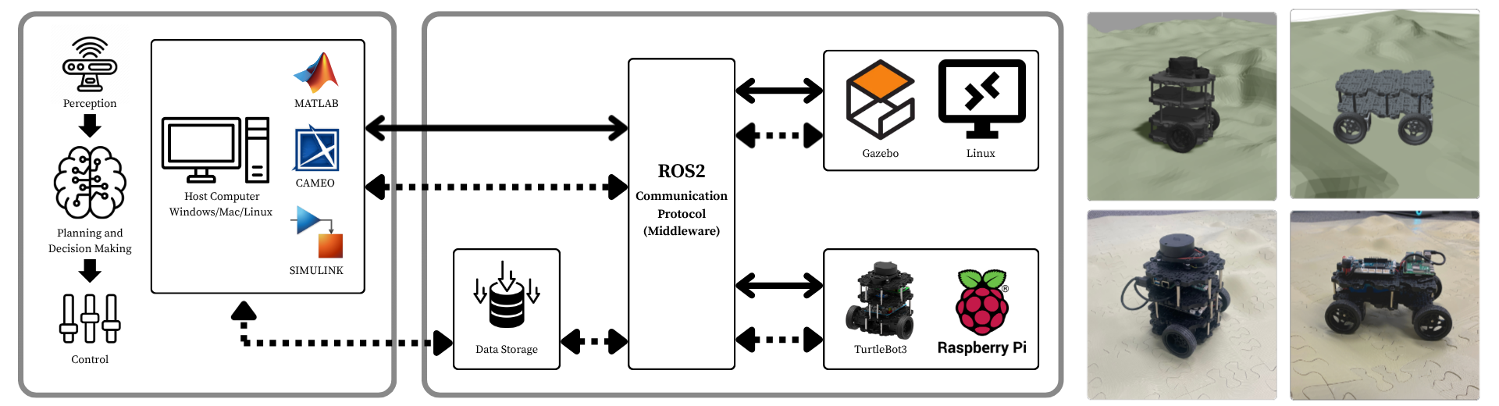
The Engineering Environment
MBSE and digital twins are both mature and already in use in this environment.
Robot Operating Software
A unified runtime enables synchronized DT-PT execution for validation
6
Notes:
This is the environment in which the workflow was implemented. On the left is the host side: Cameo holds the SysML model, and MATLAB and Simulink support behavioral modeling and analysis. ROS 2 serves as the middleware, and a data storage layer returns recorded data to the analysis tools.
[Click 1 ]The physical platform is a TurtleBot3 running on a Raspberry Pi. It operates over a terrain course we 3D printed to specified dimensions, with hills and both smooth and bumpy surfaces.
[Click 2 ]Gazebo, a physics-based simulator, provides the digital representation. The digital environment was built to match both the vehicle and that same test course.
[Click 3 ]Both sides run on common interfaces and common message definitions, which is what permits direct comparison between them.

Slide 7
The Gap: What’s Missing Today
MBSE and Digital Twins are both mature. The process connecting them for verification is not.
Abstraction Gap
SysML models stay abstract by design; Digital Twins need explicit parameters and runtime execution. Nothing formally bridges the two.
Fragmented Processes
Models and simulations run in parallel, so verification happens offline or manually, decoupled from model evolution.
Externalized Logic
Evaluation logic lives in tool-specific scripts, breaking the digital thread.
No Closed Loop
Results are interpreted after execution, never fed back into the system model.
The missing piece: a defined workflow that connects requirements to automated verification and carries results back to the MBSE model.
7
Notes:
MBSE and digital twins are both mature. The process connecting them for verification is not. We identified four gaps.
[Click 1 ]First, an abstraction gap. SysML models are abstract by design, while digital twins need explicit parameters and runtime execution, and nothing formally bridges the two.
[Click 2 ] Second, process fragmentation. Modeling and simulation run in parallel rather than in sequence, so verification happens offline or by hand.
[Click 3 ] Third, no closed loop. Results are interpreted after execution and not returned to the model.
[Click 4 ] Fourth, externalized evaluation logic. The criteria that decide pass or fail sit in scripts outside the model, breaking the thread where the engineering judgment is applied.
[Click 5 ] What is needed is a defined workflow that connects requirements to verification execution and carries the results back to the model.

Slide 8




The Proposed Workflow
Four sequential phases establish a continuous digital thread between requirements, models, and verification results.
1 SPECIFY
Model requirements, components, and test cases in SysML with verify and satisfy links.
2 TRANSFER
Export requirements via ReqIF and import them into the digital twin environment.
Closes the four gaps
No Closed Loop: the loop propagates results back to the model.
Fragmented Processes: four defined phases replace parallel, manual steps.
Abstraction Gap: ReqIF exchange links SysML to the executable environment.
Externalized Logic: test functions are linked to requirements inside the thread.
Cameo
ReqIF
4 FEED BACK
Propagate pass, fail, and partial outcomes back to the model to update each requirement.
3 EXECUTE
Link requirements to Simulink components and test functions, then run and evaluate.
Cameo (updated model)
MATLAB · Gazebo · ROS2
8
Notes:
The proposed workflow has four sequential phases.
[Click 1 ]Phase 1, Specify. Requirements, components, and test cases are modeled in SysML within Cameo, connected through verify and satisfy relationships.
[Click 2 ]Phase 2, Transfer. Requirements are exported using ReqIF and imported into the digital twin environment.
[Click 3 ]Phase 3, Execute. Each requirement is linked to the component that implements it and the test function that verifies it. The simulation is then run and the outputs evaluated.
[Click 4 ]Phase 4, Feed Back. Pass, fail, and partial outcomes are returned to the Cameo model and recorded against each requirement.
[Click 5 ]Each phase addresses one of the four gaps. I will walk through each as it was implemented.

Slide 9
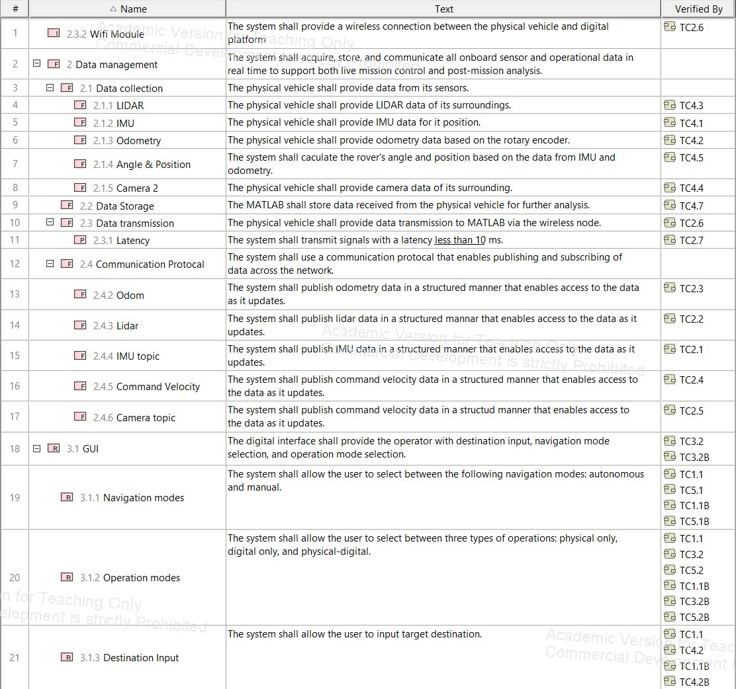
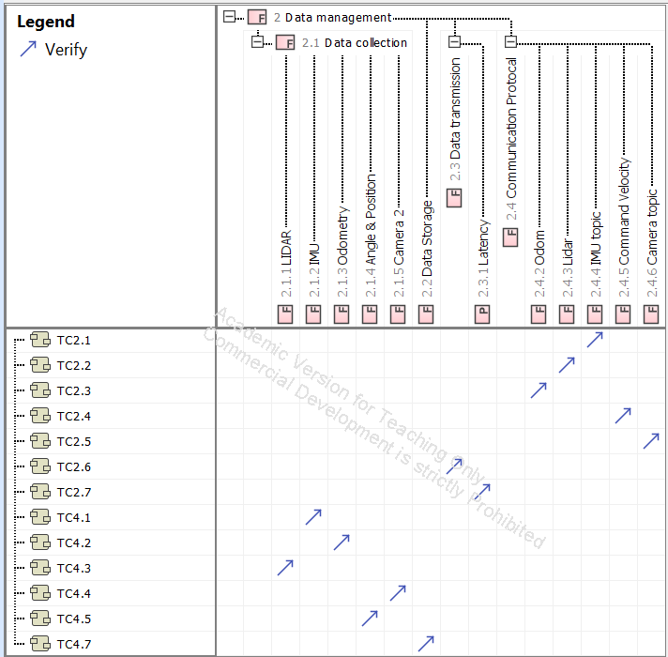
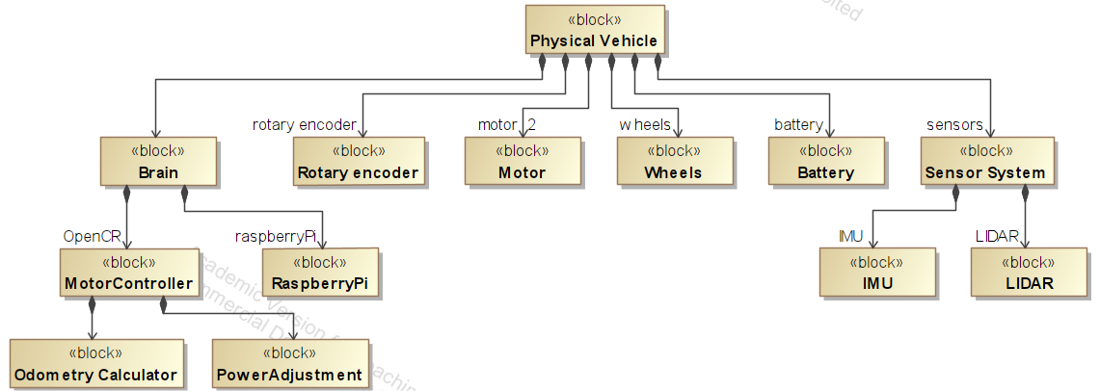
Phase 1: Specification and Planning in the MBSE Model
Requirements, system components, and test cases are all modeled in Cameo Systems Modeler.
Requirements
System components
Test cases
Traceability is captured through verify links (requirement to test case) and satisfy links (requirement to component) in the verification and satisfaction matrices.
9
Notes:
Phase 1 is performed entirely within Cameo.
[Click 1 ] On the left are the requirements, decomposed hierarchically, each a shall statement with its verifying test case identified.
[Click 2 ] In the center is the system structure, where the physical vehicle block decomposes into its subsystems and down to the individual components.
[Click 3 ] On the right are the test cases, connected to the requirements in the verification matrix.
[Click 4 ] Traceability is established here, before any execution. Verify relationships connect requirements to test cases and satisfy relationships connect them to components. Every later phase depends on this layer.

Slide 10
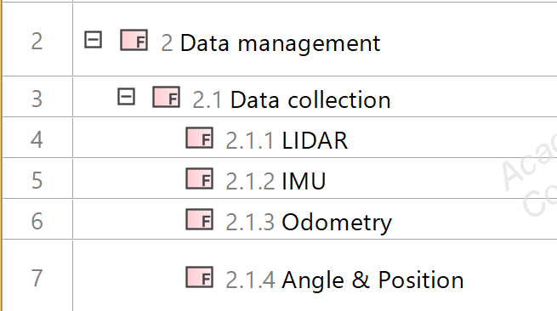
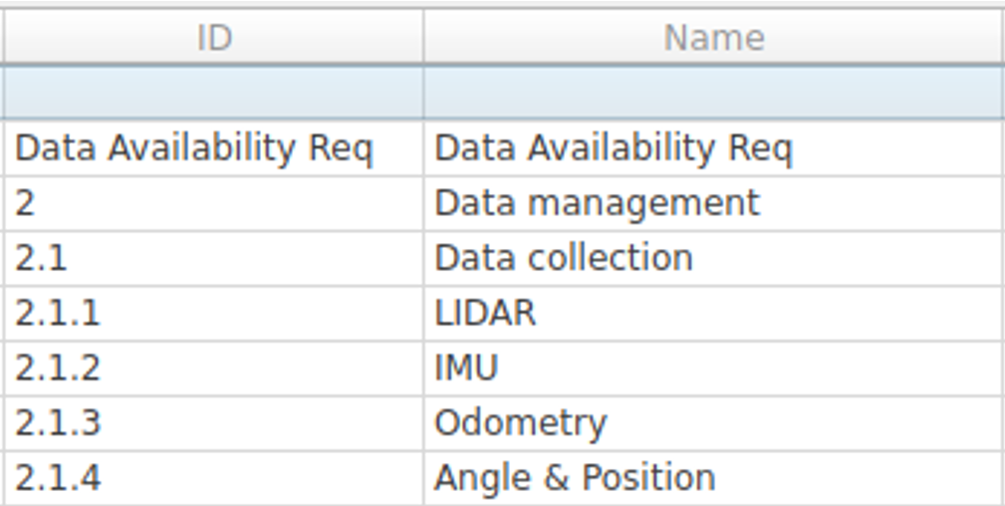
Phase 2: Transfer of Executable Requirements
Requirements move from the MBSE environment (Cameo) to the digital twin environment (MATLAB and Gazebo) as a ReqIF file, an OMG standard that preserves requirement hierarchy, attributes, and traceability during transfer.
MBSE ENVIRONMENT · Cameo
DIGITAL TWIN ENVIRONMENT · MATLAB & Gazebo
ReqIF
Before Import
After import
EXECUTABLE
REQUIREMENTS
ReqIF transfers requirement elements and attributes. Test case content is not preserved as an executable artifact, so it serves as the specification basis for configuring the simulation and implementing the test functions.
10
Notes:
Phase 2 moves the requirements into the execution environment using ReqIF, the Object Management Group standard for requirements interchange. Because it is an open standard, the source can be any tool that supports it, such as IBM DOORS or Siemens Polarion.
[Click 1 ] On the left is the requirement hierarchy as defined in Cameo.
[Click 2 ] On the right is the same hierarchy after import into MATLAB. Identifiers, names, structure, and attributes are preserved, so results from execution can be matched to the corresponding requirement in the model.
[Click 3 ] One limitation. ReqIF transfers the requirement elements and their attributes, but not the test cases as executable artifacts. Those serve as the specification basis for the test functions, which are implemented on the MATLAB side.

Slide 11
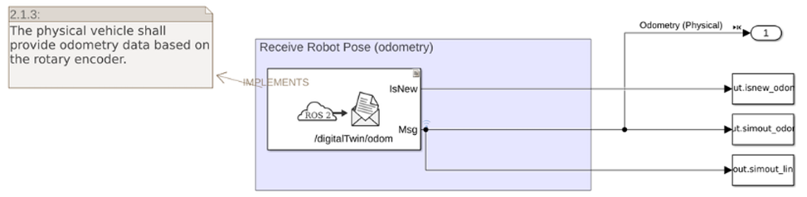
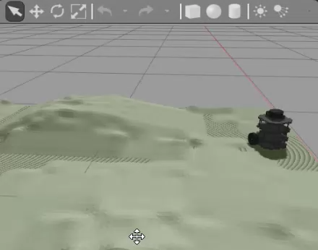
Phase 3: Verification Execution in the Digital Twin
1 Link requirements to Simulink subsystems (Implemented By)
3 Run the simulation and evaluate outputs (Gazebo)
2 Create test functions and link to requirements (Verified By)
classdef TC4_6 < sltest.TestCase​
methods (Test)​
function testIMUUpdateRate(testCase)​
model = "scSystemLogicalArchitecture";​
stopTime = "30";​
minRate = 100; %Hz​
simOut = sim(model, "StopTime", stopTime);​
isnew = simOut.get("isnew_IMU");​
newMsgTimes = isnew.Time(logical(isnew.Data));​
dt = diff(newMsgTimes);​
avgRate = 1 / mean(dt);​
testCase.verifyGreaterThanOrEqual(avgRate, minRate, ...​
sprintf("FAIL: IMU update rate %.2f Hz is below %.0f Hz threshold.", ...​
avgRate, minRate));​
end​
end​
end​
11
Notes:
Phase 3 is where verification is executed, in three steps.
First, each requirement is linked to the Simulink subsystem that implements it, through an Implemented By relationship. Here, requirement 2.1.3, odometry data from the rotary encoder, is linked to the subsystem that receives it over ROS 2.
Second, a test function is written and linked to the requirement through a Verified By relationship. This one runs the model for thirty seconds, measures the IMU update rate, and checks it against the minimum threshold.
Third, the simulation is executed against the Gazebo environment.
[Click video ] This is the simulation running in the Gazebo environment. It represents the physical vehicle under the same conditions, in a physics-based simulator.
As it runs, it produces the same sensor and vehicle data the physical platform would, and that data is recorded.
Once the run completes, the test functions evaluate the recorded data, each returning a pass or fail result with its measured outcome. Because they are automated, large numbers of test cases can run together.
Third, the simulation is executed against the Gazebo environment.
[Click video] This is the vehicle executing in the Gazebo environment while the test functions record the message streams.
The physical platform runs the same architecture over the same ROS 2 interfaces.
Because the test functions are automated, this step scales. Large numbers of test cases can be executed in a single run, with results reported on completion.

Slide 12
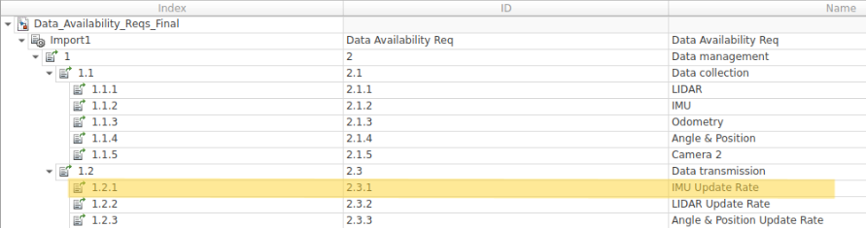
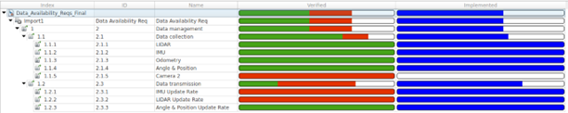

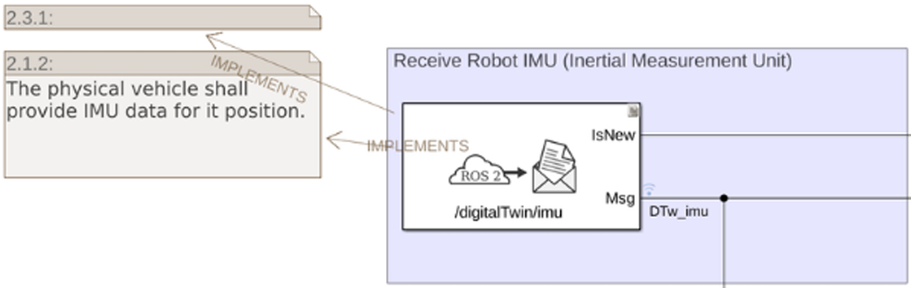
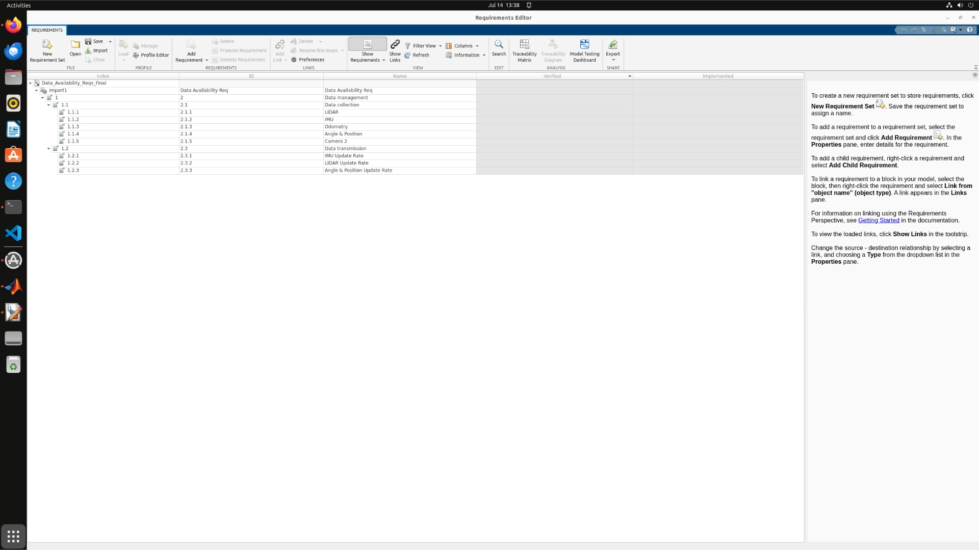
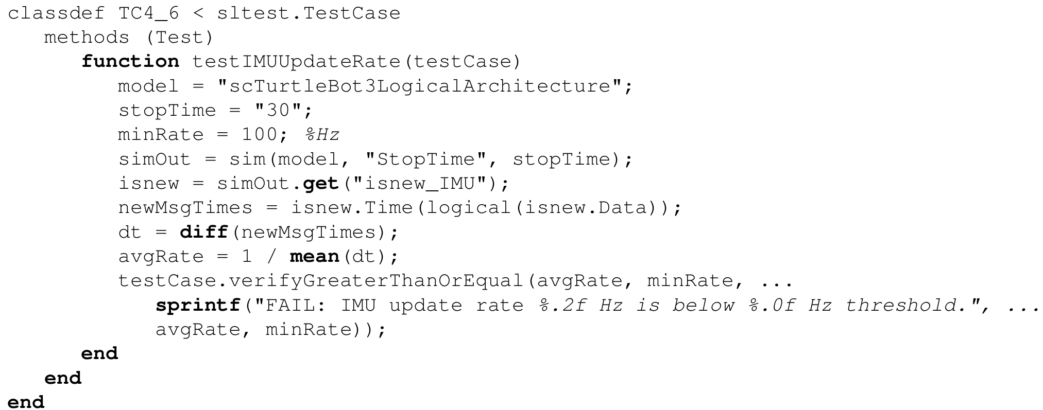

Requirement to Verified Outcome
A worked test case: IMU update rate (TC4.6)
All test cases at a glance
REQUIREMENT · Req 2.3.1
The vehicle shall provide IMU data at a minimum update rate of 100 Hz.
LINKED COMPONENT · Implemented By
IMU Data, a Simulink subsystem.
Requirement traceability chart with test results (MATLAB Requirements Toolbox)
The workflow runs many test cases automatically, not just this one.
All results propagate back to Cameo, updating each requirement’s verification status.
TEST FUNCTION · Verified By
TC4_6 testIMUUpdateRate collects message timestamps over a 30 s window, computes the average update rate, and compares it against a 100 Hz threshold.
MEASURED OUTCOME
97.4 Hz against the 100 Hz threshold.
FAIL - a narrow miss that may warrant requirement renegotiation.
Traceability chart key
Pass
Fail
Implemented
12
Notes:
This slide traces one requirement through the full chain.
[Click 1 ] The requirement states that the vehicle shall provide IMU data at a minimum update rate of 100 hertz. On the right is that requirement in the model, 2.3.1, IMU Update Rate.
[Click 2 ] It is implemented by the IMU Data subsystem in Simulink, shown here with the Implements relationship drawn from the requirement.
[Click 3 ] It is verified by test function TC4_6, which measures the average update rate over a thirty-second window and compares it to the 100 hertz threshold.
[Click 4 ] The measured result was 97.4 hertz against the 100 hertz threshold, recorded as a fail.
This is the test executing and reporting that result.
This result is a small miss. A number that close to the threshold points to the requirement more than the design. It was written at 100 hertz without checking what the sensor could sustain. We caught that in simulation, before any hardware decision depended on it, while the requirement can still be revisited.
[Click 5 ] The workflow runs many test cases automatically, not just one. The chart shows the full requirement set: green is pass, red is fail, and blue indicates the requirement is implemented by a linked component.

Slide 13
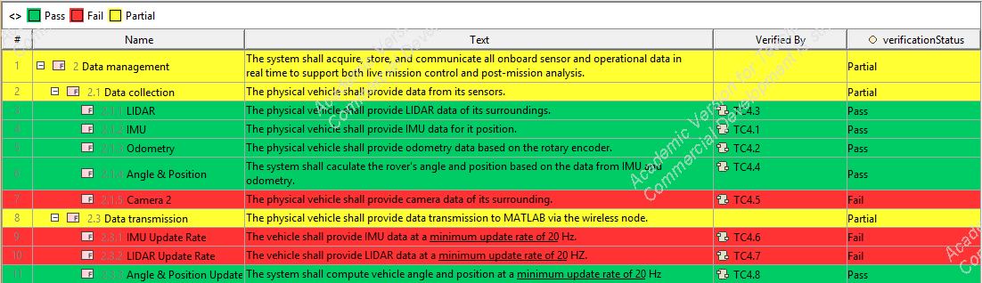
Phase 4: Close the Loop
Bidirectional traceability
Requirement definition, digital twin evaluation, and verification status stay linked within the system model.
Results propagate back to the Cameo model, closing the loop:
▸ Each requirement's verification status is updated: pass, fail, or partial.
▸ The verification outcomes now reflected in the requirements table.
Requirement verification status updated in Cameo Systems Modeler
13
Notes:
Phase 4 returns the verification results to the system model.
The return path is performed manually. Results are reviewed in MATLAB and recorded against each requirement in Cameo.
To support that, the requirement definition was extended with a verificationStatus property, typed by an enumeration with three values: pass, fail, and partial. A legend color-codes each row of the requirements table by that value.
Leaf requirements carry the outcome from their test function. Parents are recorded as partial where some children passed and others failed, showing at a glance which capabilities are only partially verified.
[Click ] The outcome is bidirectional traceability. Requirement definition, evaluation, and verification status stay within the system model, which now records both the specified intent and the measured result. Automating this return path is planned work.

Slide 14
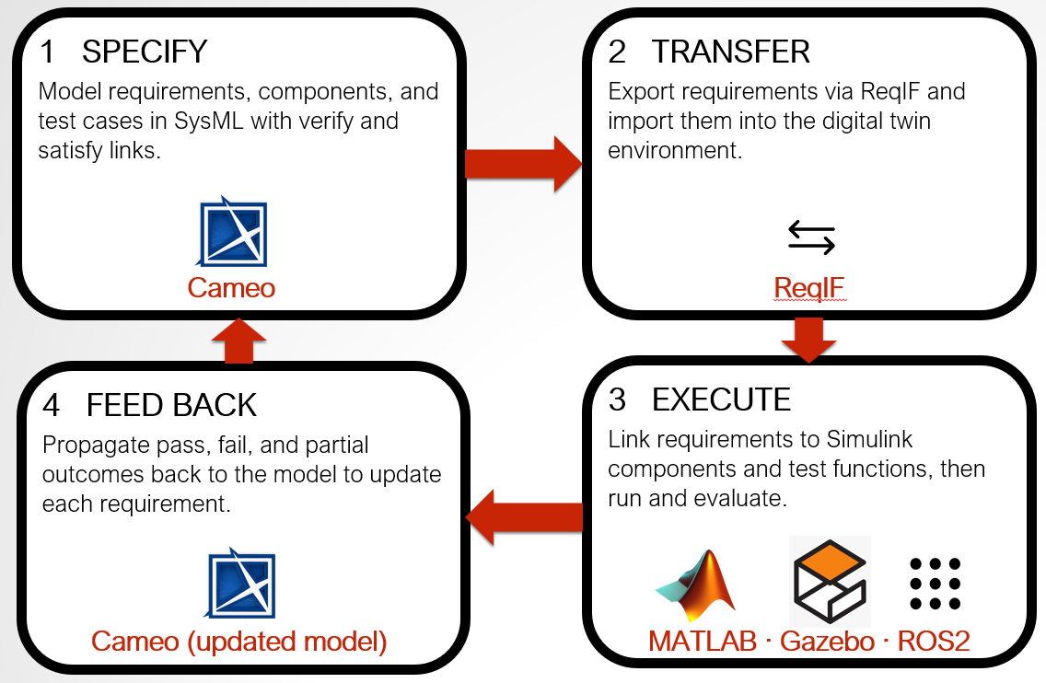
Conclusions & Future Work
MBSE + Digital Twin: 4 Gaps Closed
Abstraction Gap
ReqIF carries requirements into the digital twin as executable artifacts, with parameters and runtime behavior made explicit.
Fragmented Processes
A single structured workflow runs verification inside MBSE, replacing parallel, offline, and manual checks.
The closed-loop digital thread
Externalized Logic
“Implemented By” and “Verified By” links keep evaluation tied to the model, preserving the digital thread.
Future work
▸ Extend to more functional verification scenarios, including navigation performance assessment.
▸ Apply the workflow to more complex systems with larger requirement sets.
▸ Support interdependent verification functions across those systems.
No Closed Loop
Verification results feed back to update the MBSE model - the closed-loop digital thread.
14
Notes:
To close, against the four gaps.
[Click 1 ] ReqIF carries requirements into the digital twin environment with parameters and runtime behavior made explicit.
[Click 2 ] A single structured workflow performs verification within MBSE, replacing parallel, offline, and manual checks.
[Click 3 ] Implemented By and Verified By relationships keep the evaluation criteria tied to the model.
[Click 4 ] Verification results are returned to update the model, completing the closed-loop digital thread.
[Click 5 ] Three items of continuing work. First, extending to more functional verification scenarios, including navigation performance assessment. Second, applying the workflow to more complex systems with larger requirement sets. Third, supporting interdependent verification functions across those systems.

Slide 15
Thank You!
Omar Zeki
ozeki@gmu.edu
15
Notes:
Thank you for your time. I would be glad to take any questions.

Slide 16
Backup: Full Test Case Results
Test ID​ | Description​ | Threshold​ | Result​ | Status​
TC4.1​ | IMU Data Availability​ | Valid sample​ | Received​ | PASS​
TC4.2​ | Odometry Availability​ | Valid sample​ | Received​ | PASS​
TC4.3​ | LIDAR Data Availability​ | Valid sample​ | Received​ | PASS​
TC4.4​ | Angle (Heading/Yaw)​ | Valid sample​ | Received​ | PASS​
TC4.5​ | Position (X/Y)​ | Valid sample​ | Received​ | PASS​
TC4.6​ | IMU Update Rate​ | ≥ 100 Hz​ | 97.4 Hz​ | FAIL​
TC4.7​ | LIDAR Update Rate​ | ≥ 5 Hz​ | 2.9 Hz​ | FAIL​
TC4.8​ | Angle/Pos Update Rate​ | ≥ 20 Hz​ | > 20 Hz​ | PASS​
TC-Cam​ | Camera Availability​ | Valid sample​ | No model​ | FAIL​
16

